Slide 1


Twitter Data in the NBA
Jean Chakmakas and Lauren Kemperman

Slide 2
Project Goals
Interested in characterizing fans of different teams
Are the most popular teams the most liked? Are the teams that are doing the best associated with positive sentiment, and the worst teams negative sentiment?
Use twitter data to characterize fans and understand how they are different

Slide 3
Data Collection
Used Tweepy module in python to download tweets
Download followers of team accounts
Track keywords
Bounding box
Decided to focus on: tweets collected by keyword from top two and bottom two teams
Cavaliers, Mavericks, Raptors, 76ers

Slide 4
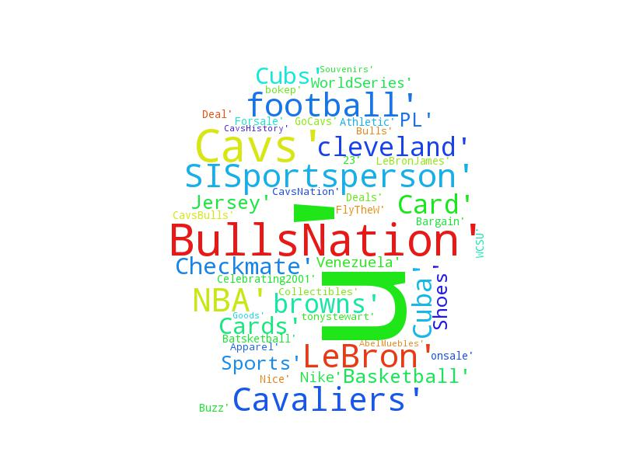
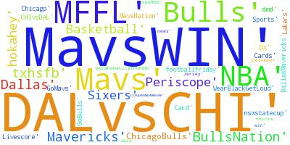
Analysis
Looking at tweet content: popular hashtags

Slide 5
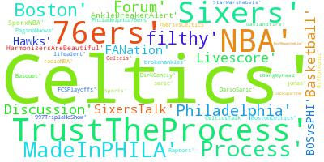
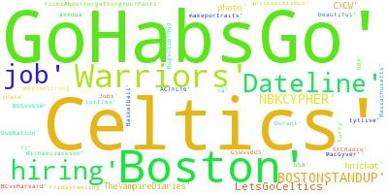
Analysis
Looking at tweet content: text in tweets
Tweets collected from TD Garden on game vs. Warriors
Terms collected from Philly 76ers based on keywords

Slide 6
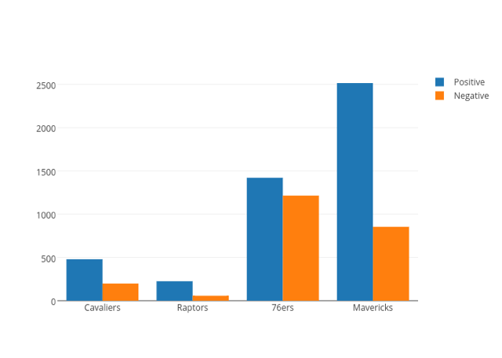
Analysis
Positive and negative sentiment of tweets
Trained naïve bayes classifier with labeled dataset from Kaggle
Classified new examples from our data

Slide 8
Future analysis
Look at time series to see if tweet sentiment reflects how a team is doing during a game, and track how that changes over time

